Slide 1
ONLINE EVENT MANAGEMENT SYSTEM

Slide 2
INTRODUCTION:
Events create opportunities for people to connect with an area, spend time together, celebrate and experience the diversity of cultures and foster creativity and innovation. They allow a community to come alive and provide an opportunity for a destination to showcase its tourism experience and increase economic activity. Events contribute significantly to community building, lifestyle and leisure enhancement, cultural development, tourism promotion and increased visitation, volunteer participation, fundraising and economic development. Most importantly, events create a sense of fun and vibrancy, resulting in a strong sense of community connectivity, pride and a sense of place.

Slide 3
EXISTING SYSTEM:
This existing and some data may be lost due to mismanagement. This system is not providing event managsystem is not providing secure registration and profile management of all the users properly. This system is not providing on-line help. This system doesn’t provide tracking of users activities and their progress. This manual system gives us very less security for saving data ement through internet. This system is not providing proper events information. The system is giving manual information through the event management executer.

Slide 4
PROPOSED SYSTEM:
Mannual hours that need to spend in record keeping and generate reports is no longer required.It generate automatically.
Easy to manage data in a database.
User can register for any event from anywhere.
Event manager can update and modify records of user anytime.

Slide 5
REQUIREMENT ANALYSIS:
Operating System: Windows 10
Front-end: Html,Css,Bootstrap,Angular
Back-end: SpringBoot,Java,Spring JDBC
Database:Mysql
Tools-VsCode,Eclipse IDE

Slide 6
SCOPE OF SYSTEM:
Online Event Management System can register Users and Organizers in the system and make easier to view the information related to the bookings, venues, food items and equipment.
User/Organizer registration, User/Organizer login and admin login credential authentication.
User/Organizer need to fill required attributes to register.
Admin can add and maintain food items and equipment information.
Admin can view all user, organizer, booking and venue details.
User can view venue, food item and equipment details.
User can book event, make payment, view booking history and notifications.
Organizer can add and maintain venue details and see event details booked for venue.

Slide 7
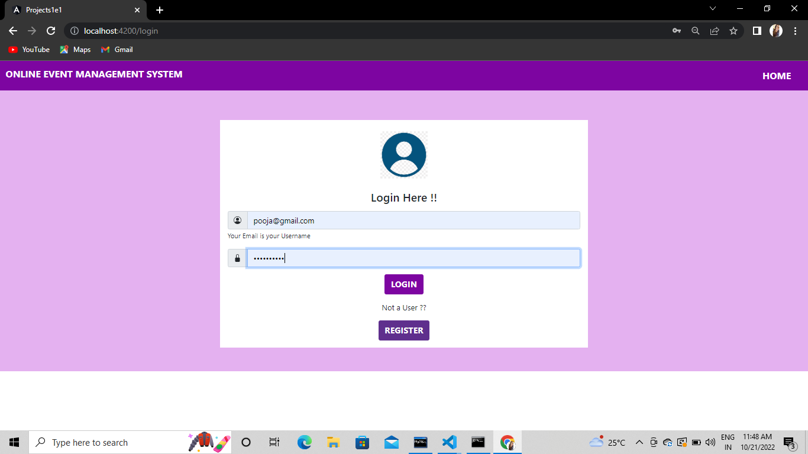
SCREENSHOTS: Login Page

Slide 8
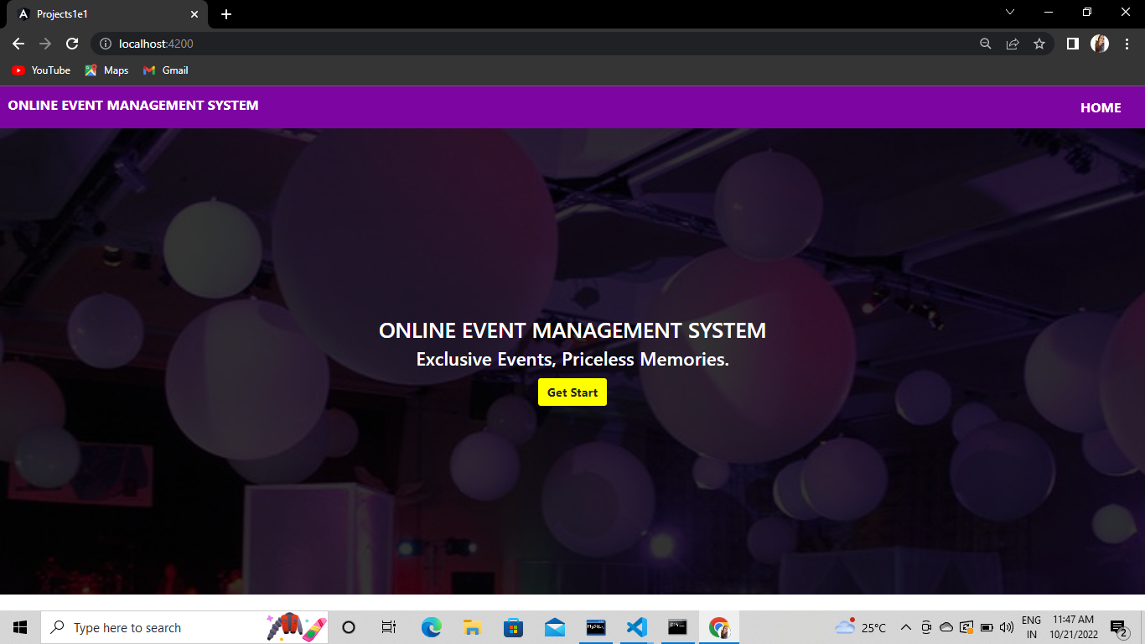
Home Page:

Slide 9
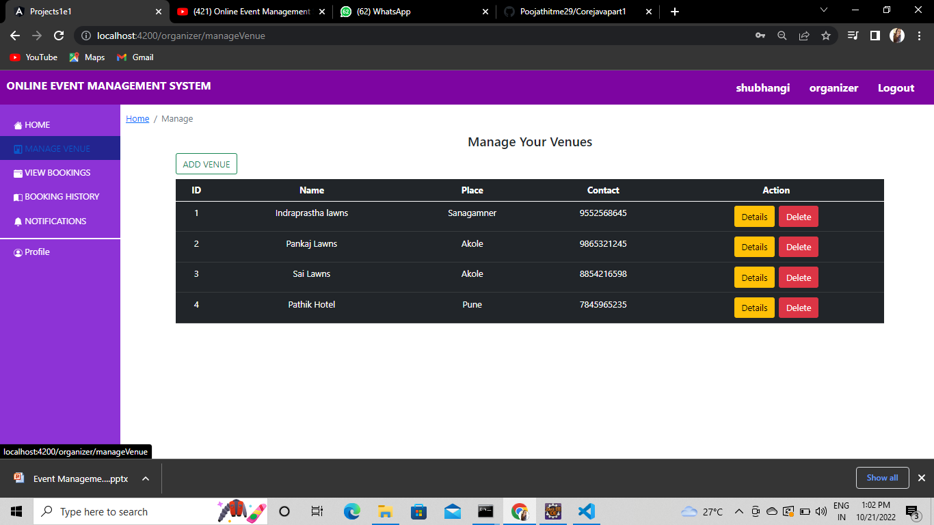
Venues:

Slide 10
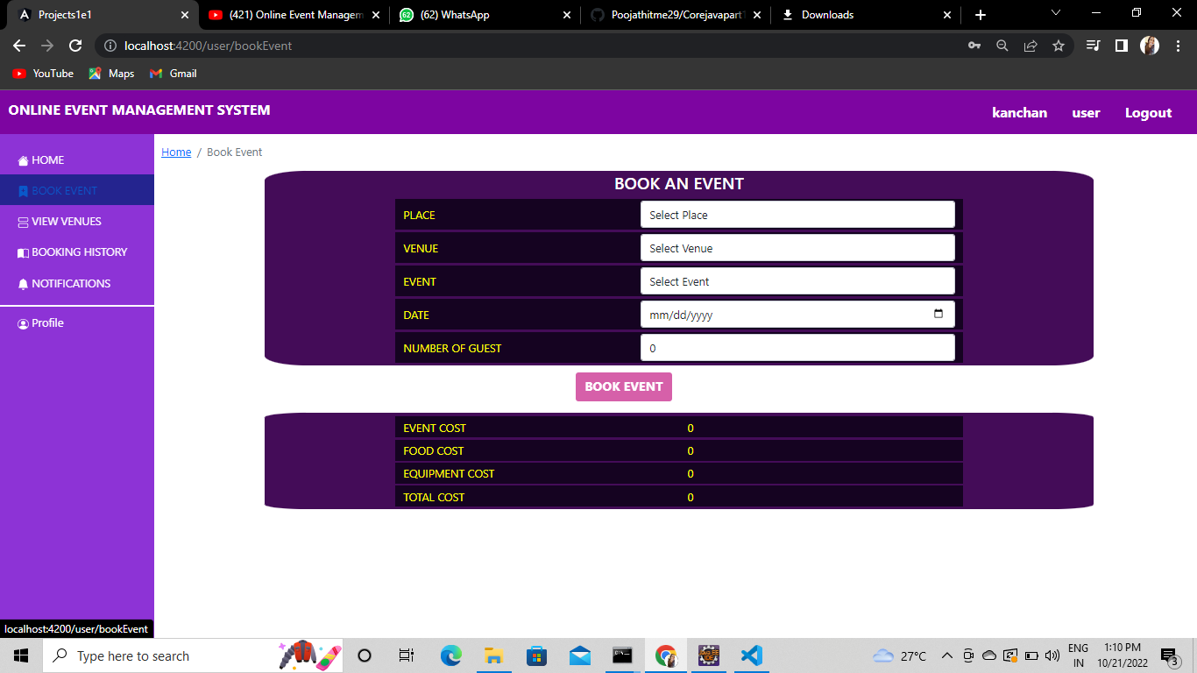
Book Event:

Slide 11
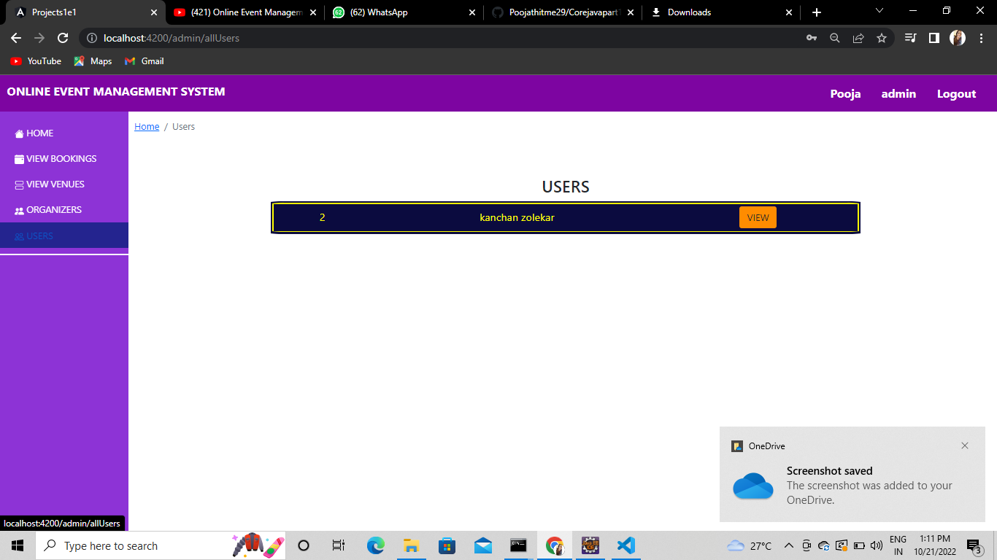
Users:

Slide 12
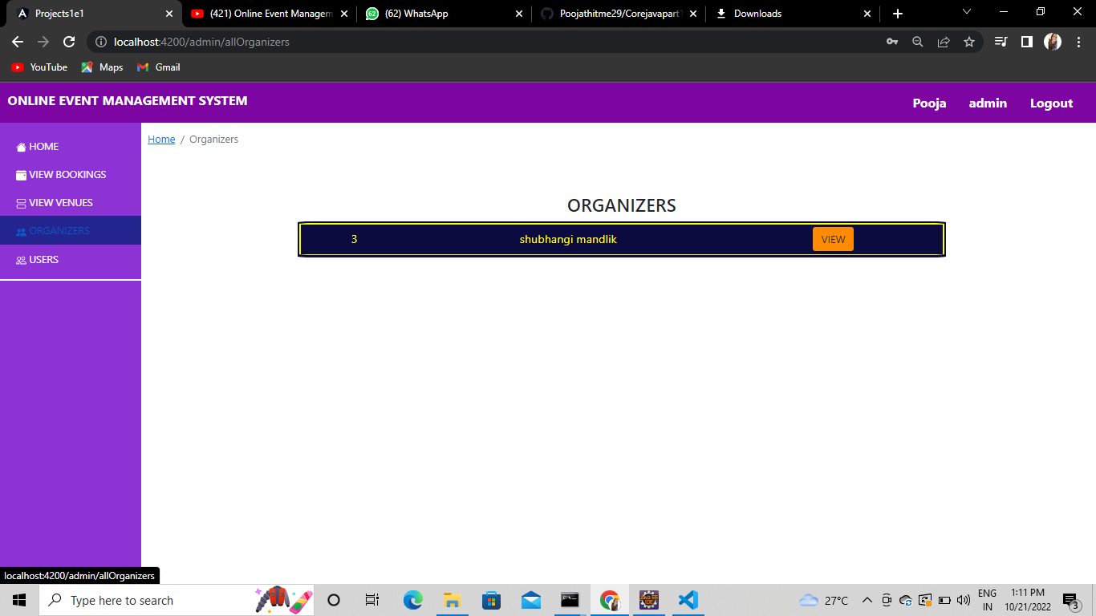
Organizers:

